Slide 1

Mobility Oppurtunities Valuable to Everybody (MOVE)
Inspiration and take aways from Gate 21 / Denmark
Anna Thormann, Gate 21
MOVE Partnermeeting, Mechelen, 05.03.2020

Slide 2
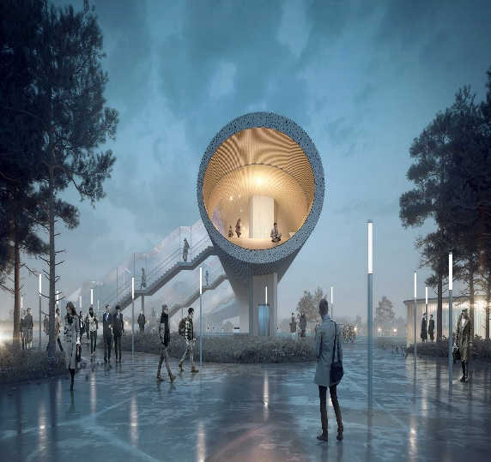
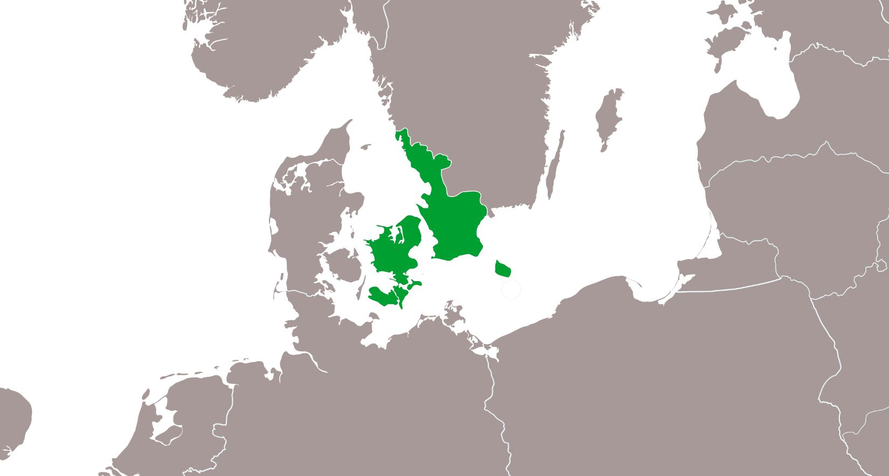

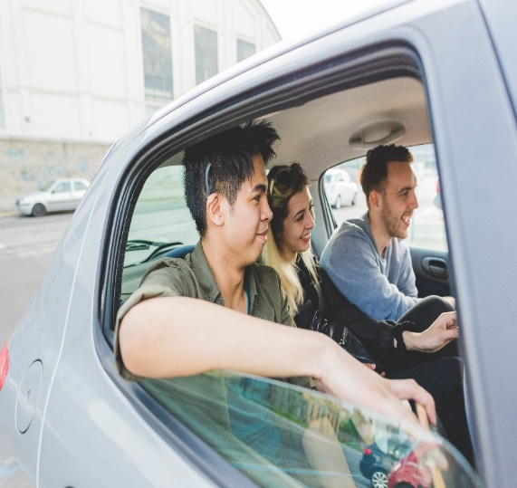




FUTURE
STATIONS
INTELLIGENT
TRAFFIC INFO
NEW
COLLECTIVE
MOBILITY IN THE
COUNTRY SITE
We want to develop, test and learn how new intelligent mobility solutions can enhance a more sustainable transportsystem.
FUTURE INTELLIGENT MOBILITY IN GREATER COPENHAGEN
d. 2. oktober 2018
Notes:
Hvad er udfordringen? Hvem har en udfordring?
Vi oplever at der bliver færre busser og droslet ned på betjeningen.
Der er teoretiske analyser af en mobilitetsfattigdom – der hvor folk har ingen eller kun en bil og ingen bus.
Men hvem oplever problemet? Og hvad er behovet?
Det er svært at finde dem der har et problem og som vil bruge en delebil.
Pointe 1.a.Vi skal have mere kvalitative undersøgelser og viden om hvem der konkret har et behov – hvilket behov.
Pointe 1.b. Bilafhængighed og øget bilbrug bliver et problem inde i byerne. Når man pendler fra by til land. Det skaber trængsel. Så vi skal have en indsats der går på at vi sætter bilen og skifter til mass-transit når vi skal ind i byerne.

Slide 4
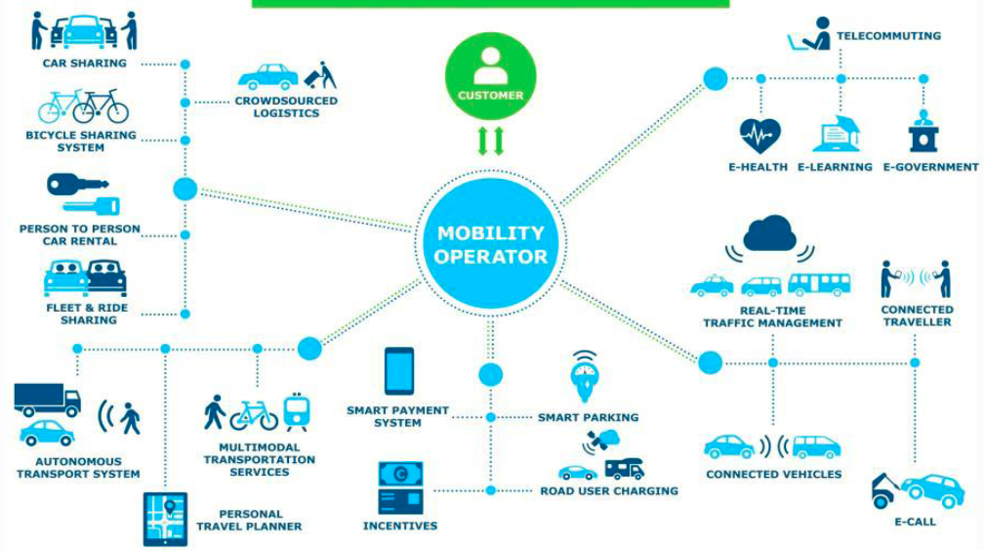
How to lead change?
How to cooperate between public and private sectors?
How to enhance the green and not be dependent on single car use?
What are our new role as planners?
Who own data and how can public authorities get hold of it?
What are the right solutions?
What data do we need to share and acces?

Slide 5
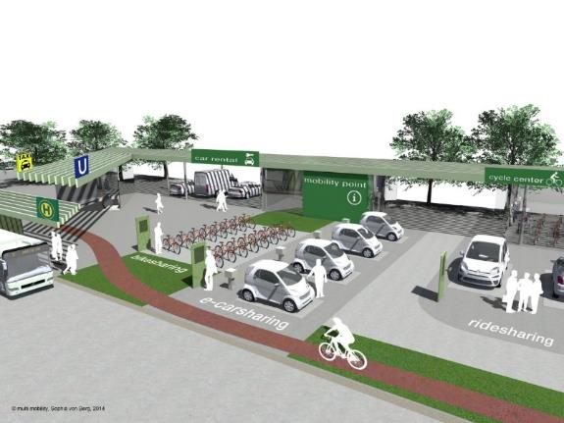
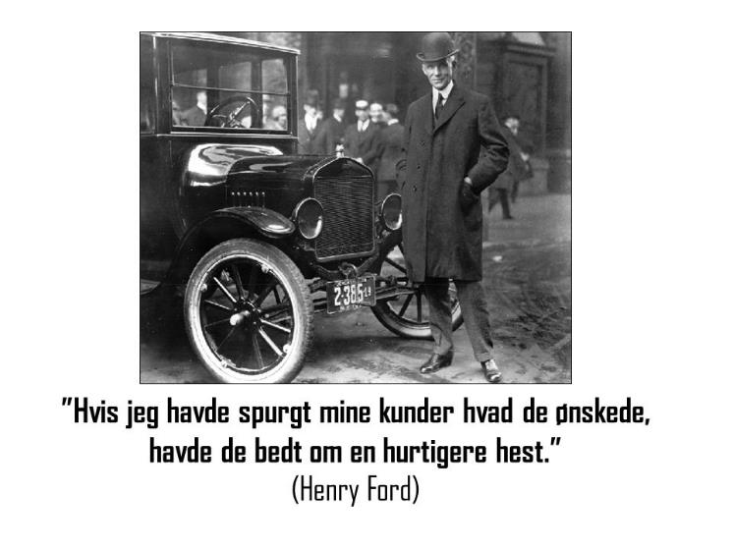
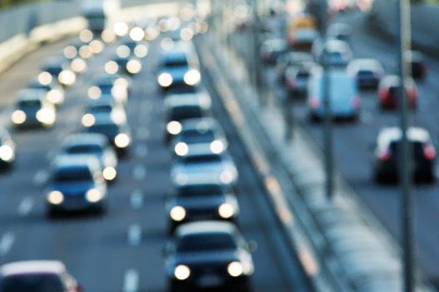
WE HAVE A DREAM….
”40 % of cardrivers want to go by bike”
(Cowi rapport 2014)
2050 I would never
own my own car
Notes:
Og det gør vores drømme og rationaler også.

Slide 6
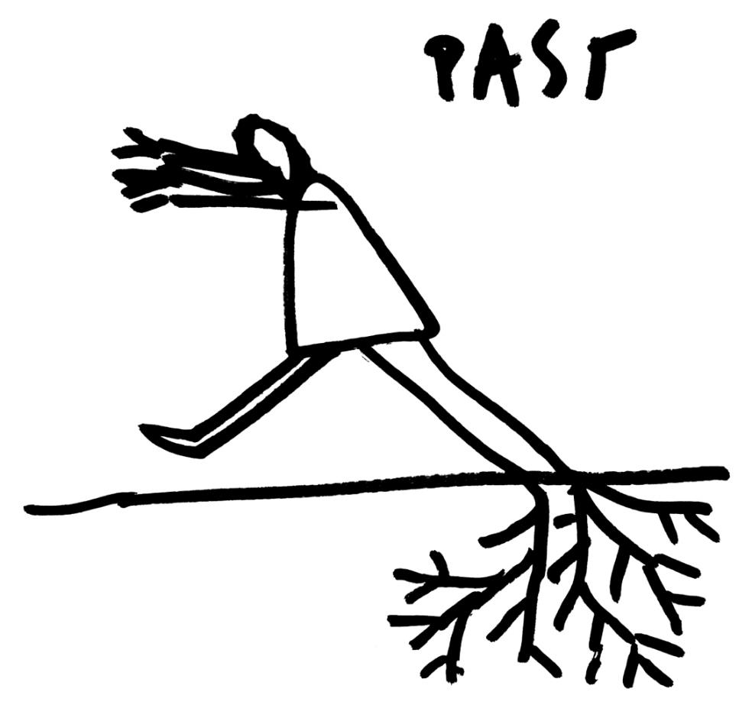
Help us change …

Slide 7
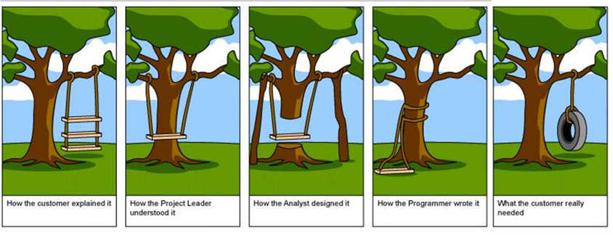
The challenge is to - not built the wrong thing
- test and prototype

Slide 8

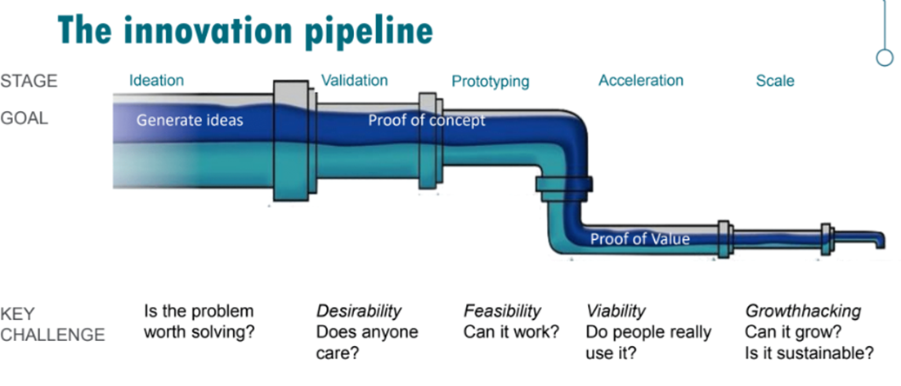
Users – citizens and the surroundings
Data availability
Public – private innovation contracts
Climate goals

Slide 9
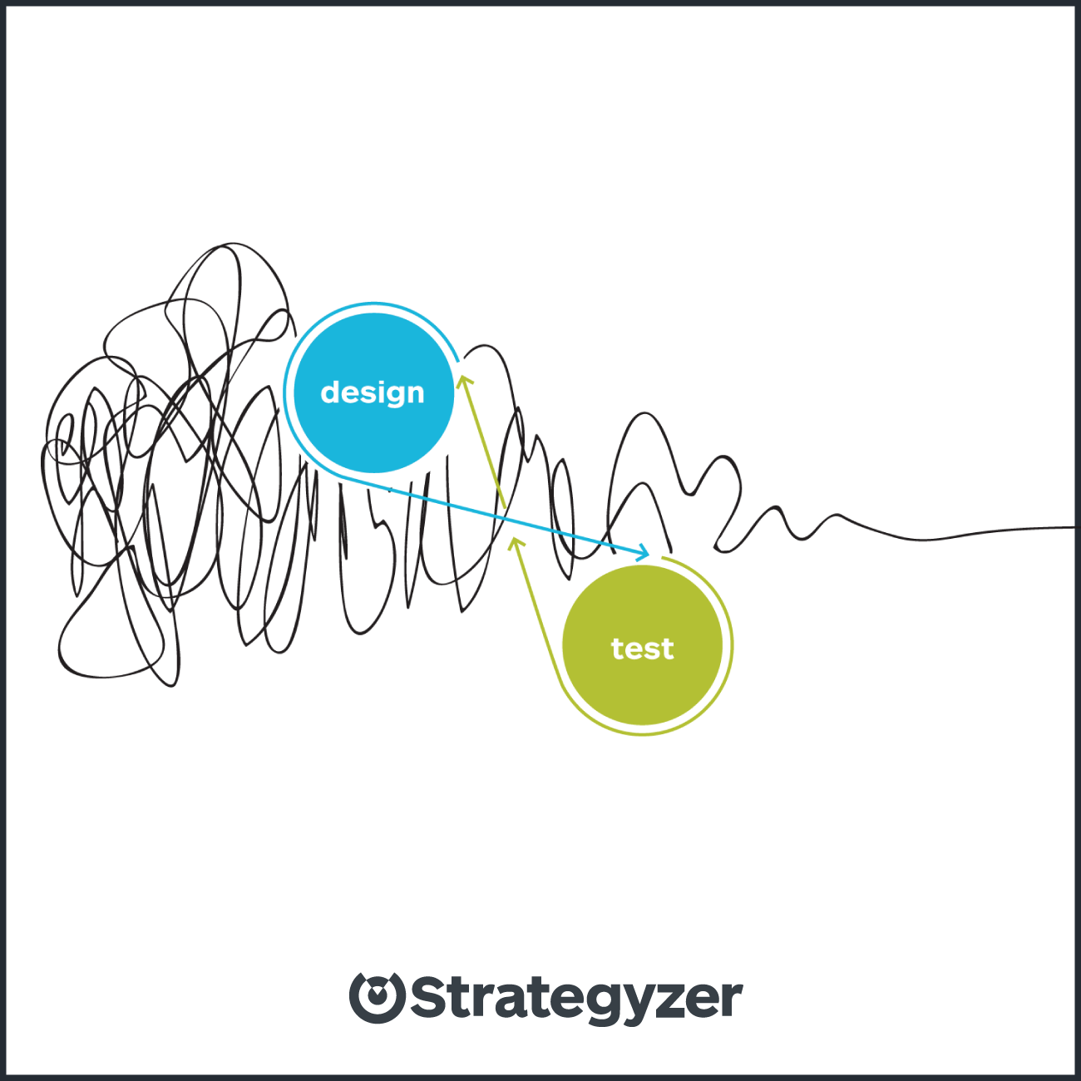
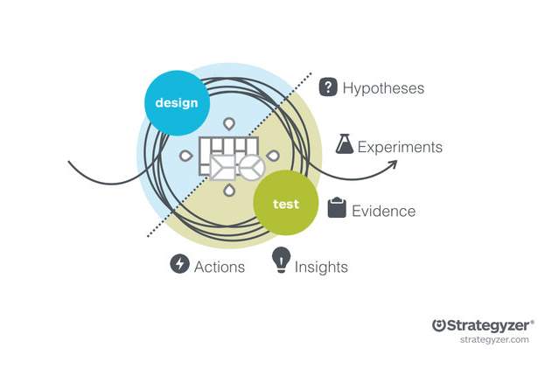
Notes:
Det kan godt være at man skal køre et par cirkler omkring design og test, før ideen er klar
Følelsen er ofte ikke få lineær/cirkulær

Slide 10
Traveltimes without a car:
Red is 1,5 – 2 hours to education.
Mobility poverty in theory
70 - 77% of all households have a car or more
Challenge: little public transport
Option: more departures using cars better
Objective: an attractive village where no one feels trapped
60% have a car
Notes:
Vi oplever at der bliver færre busser og droslet ned på betjeningen.
Der er teoretiske analyser af en mobilitetsfattigdom – der hvor folk har ingen eller kun en bil og ingen bus.

Slide 11
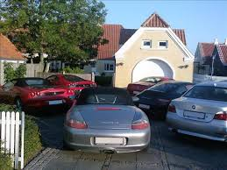
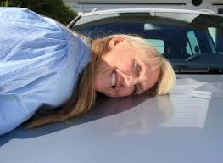
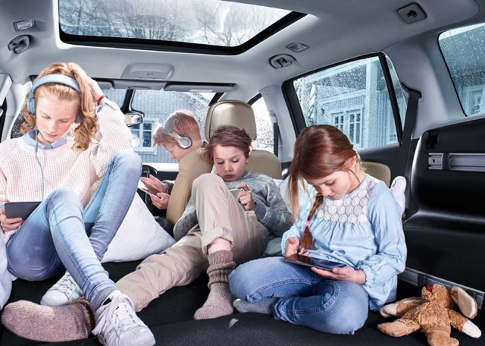
Notes:
Hvad er driveren?
Mange projekter tager udgangspunkt i at der fjernes en bus og der er støtte til et projekt om en delebil / landsby bil / shuttle.
Men det har svært ved at leve videre.
Vi skal starte et andet sted hvis der skal laves levedygtige løsninger hvor man deler de services der skal være. F.eks. de mange biler der er i indkørslerne.
Pointe 2. Den kraft der er i lokalsamfund er fællesskab og at skabe liv, så der ikke affolkes. Det er der vi skal starte og ikke at man skal dele sin bil. Det skal være attraktivt at bo der.

Slide 12
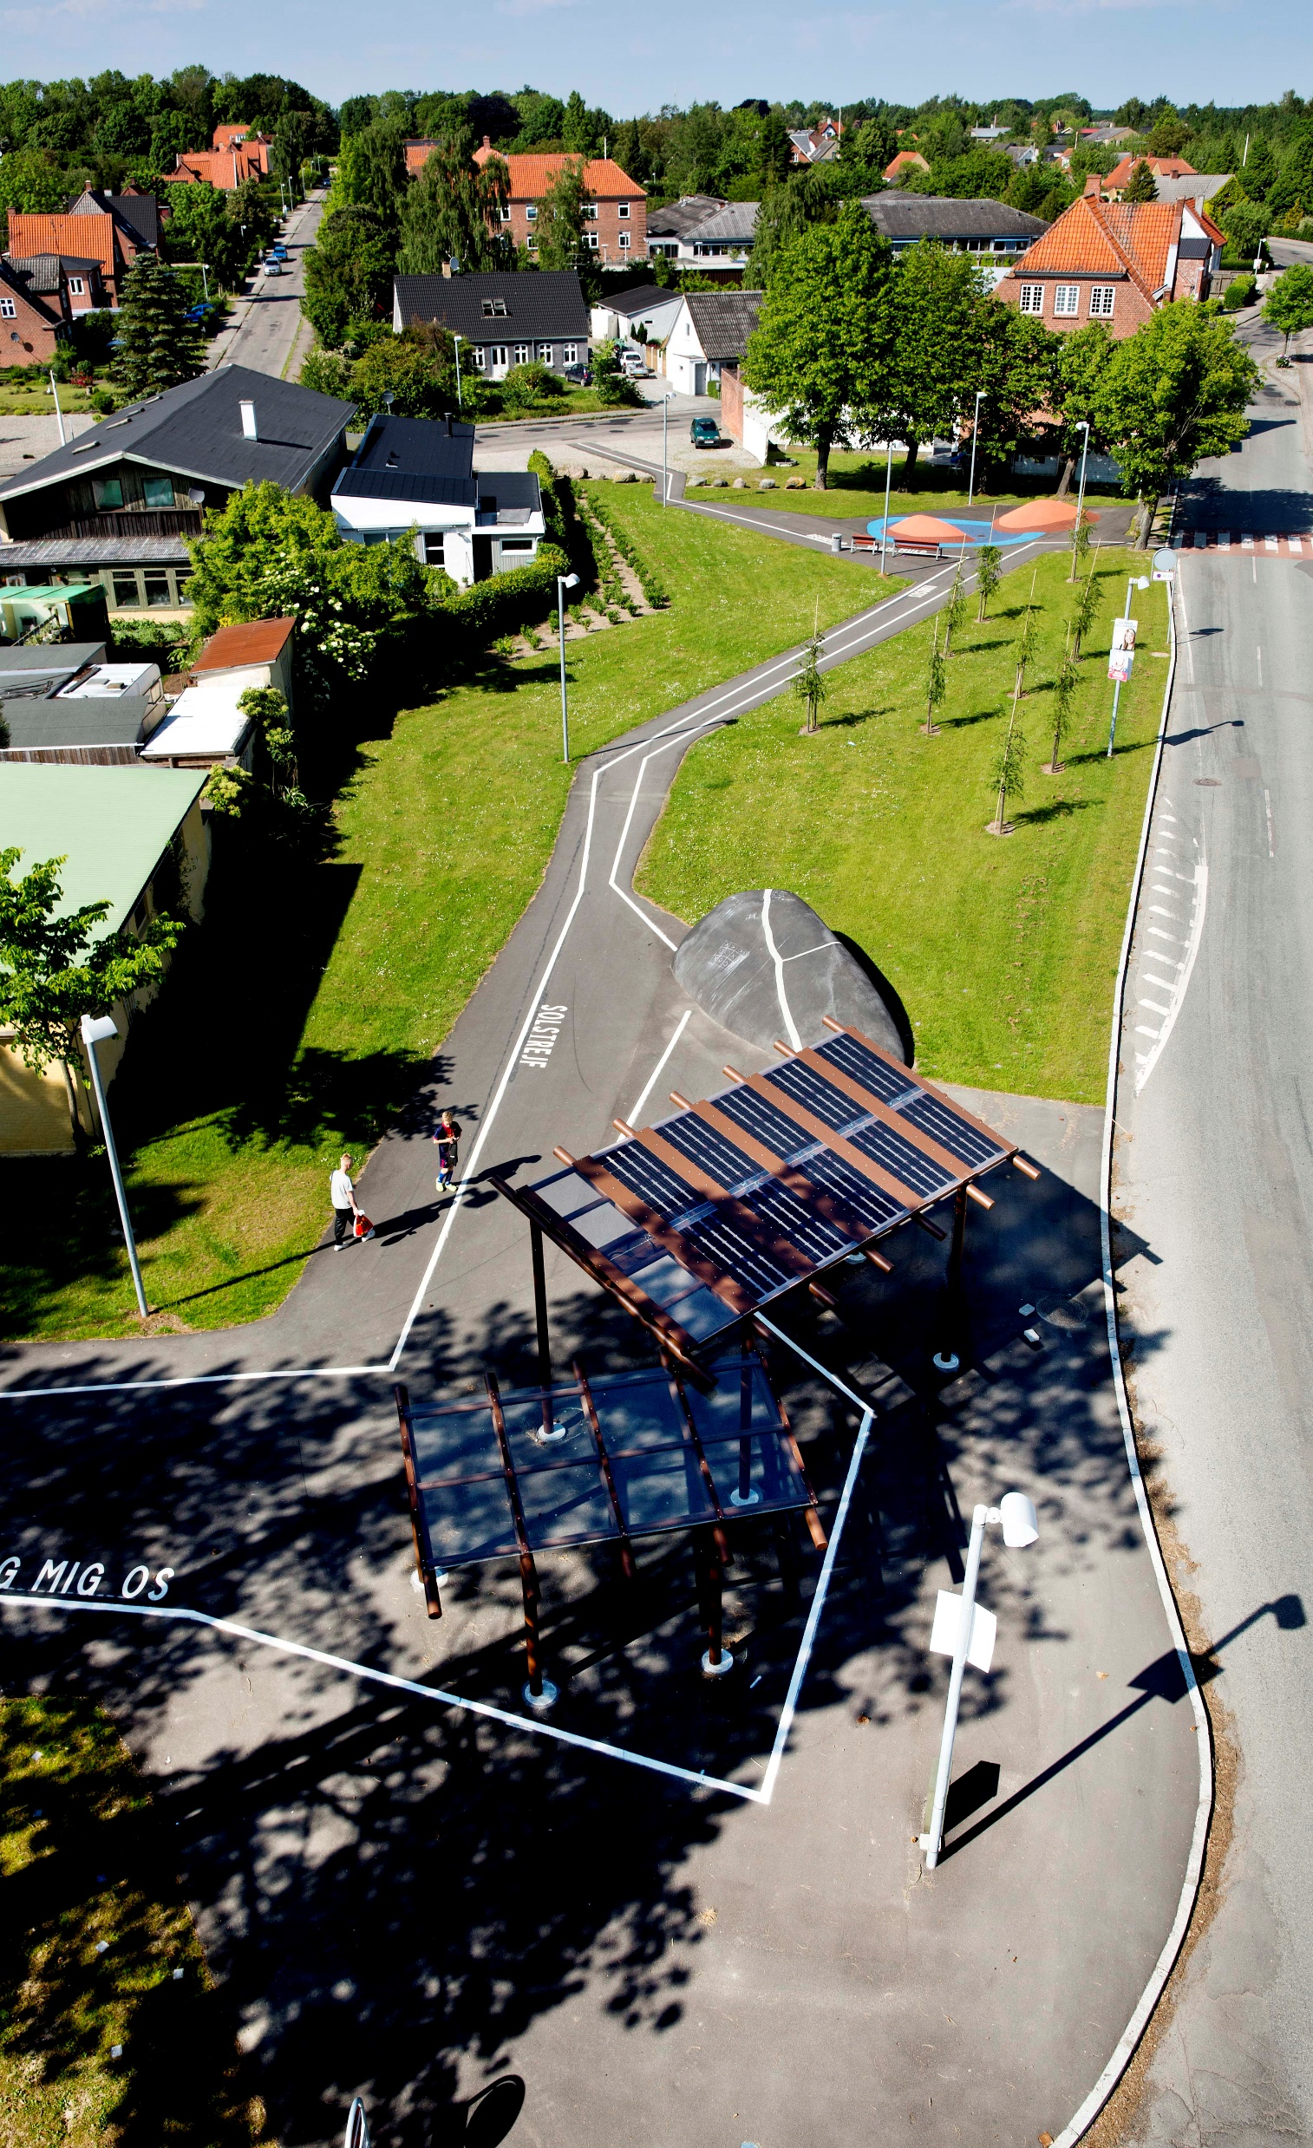
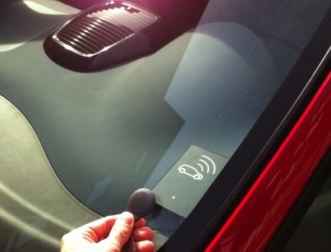
Proces is involving citizens!
Speak with people
  Questionnaires
  focus group interview
Find or develop new solutions to better combined transport
  Workshops with citizens and different suppliers
  Participate in citizens meeting
  Participate in local activities
Testing solutions
Horslunde

Slide 13
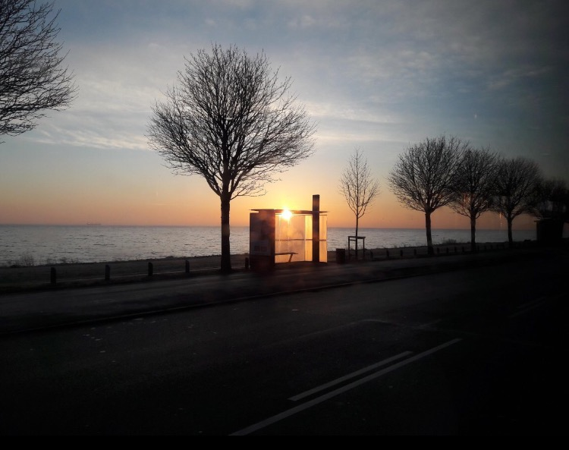
Identified target groups
Most have cars - half have more than 1
87% have used car in the past week
38% have used bicycles
22% have used bus
But 12% have failed to do something this past week due to lack of transport options
52% never use the bus, 9% use Flextur, 30% do not know!
Many people already include others in their cars - but…
1/3 would make other decisions about jobs / leisure / shopping if they were not limited by transport
Young people for leisure
Elderly for shopping
Families when their children have activities

Slide 14
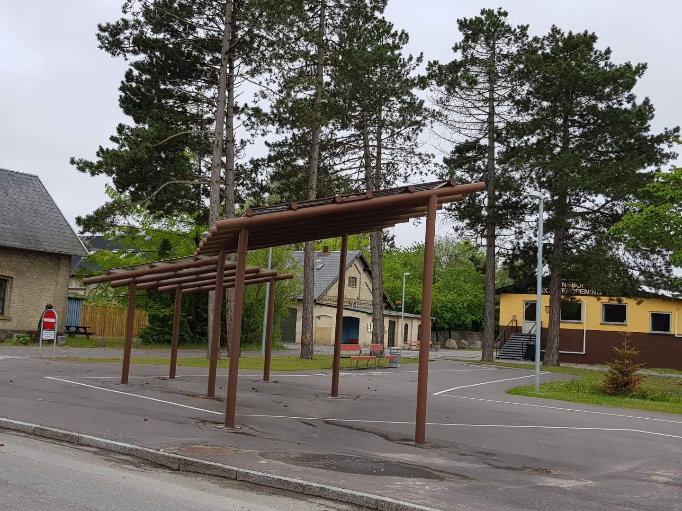
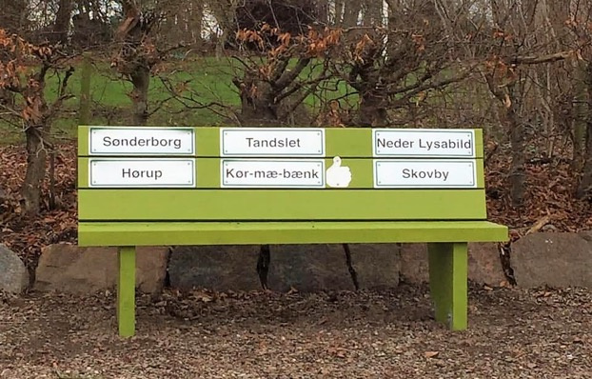
Løsninger i landsbyen
New business models
Local empowerment
El-Delebiler
El-ladcykler
Nabo biler
Samkørsel
Bus
Flextrafik
Plusture
Skolebus
ViGo
Pakkeudlevering
Pop Up butikker
Landsby app?
Horslundes TrafikHub
PoP Up butikslokale
Solcelle med ”real tids” tavle
Movia og kommunale tilbud
Overnatning for turister
Nem boks til pakker
Forsamlingshuset med mødelokaler, køkken, ”flyverarbejdspladser” m.m.
Cykelstativ og dele-ladcykel
Blafferbænk
Ladestander el-delebil

Slide 15


Evaluation of changes and processes on how
It is sustainable - governance
Michael johansson & Torleif Bramryd / Miljöstrategi – ism – lunds universitet
How to use data, share data, own data, be better with data?
What are the barriers?
What are the solutions on a local level on the way to sustainable MaaS?
What are the new roles for planners with new solutions
- that need data,
- need public – private partnerships,
- that need co-creation?

Slide 16
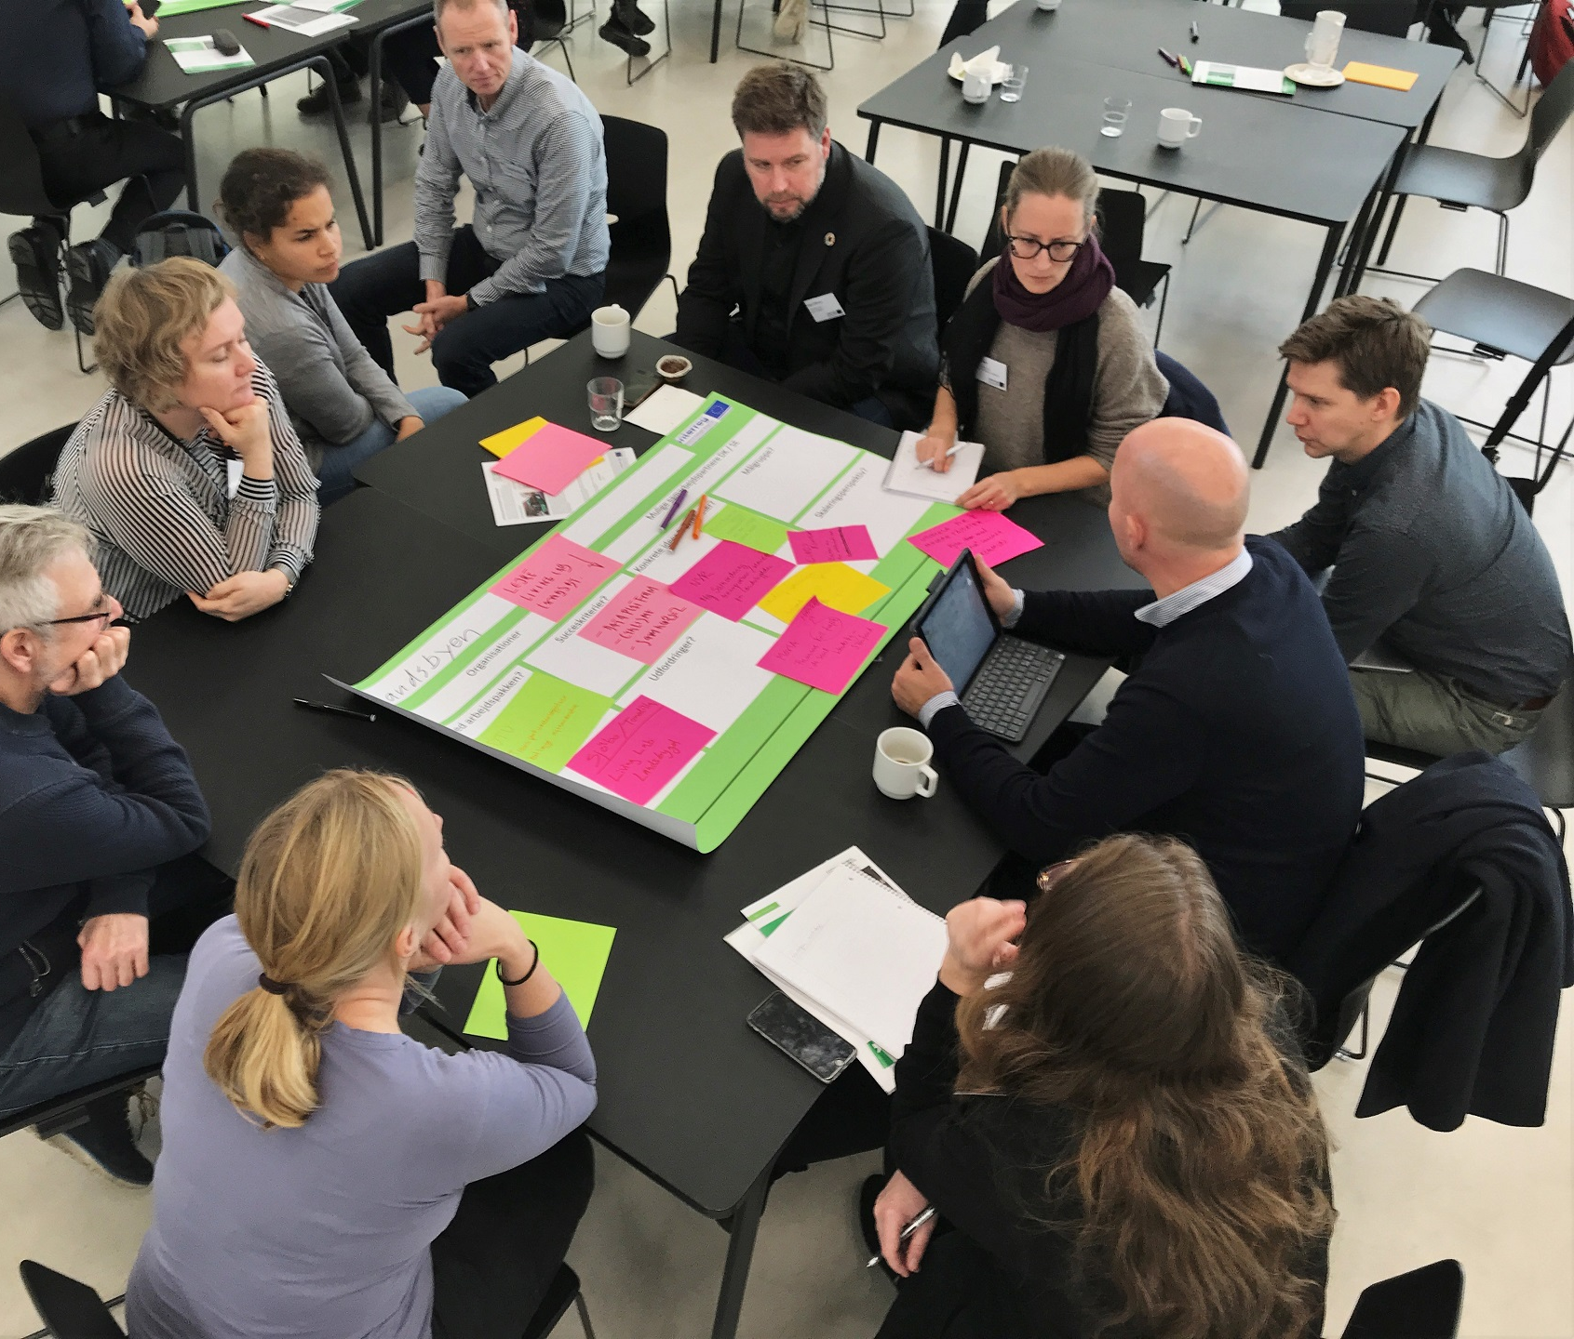
New application:
Mobility across
– geografies, boundaries and across modes
Living labs in the small village: how is the model for a sustainable transport?
Combined transport from country site to cities
electric bikes to stations, park and ride, ev charging in rural stations.
Ride sharing across in travel corridors

Slide 18
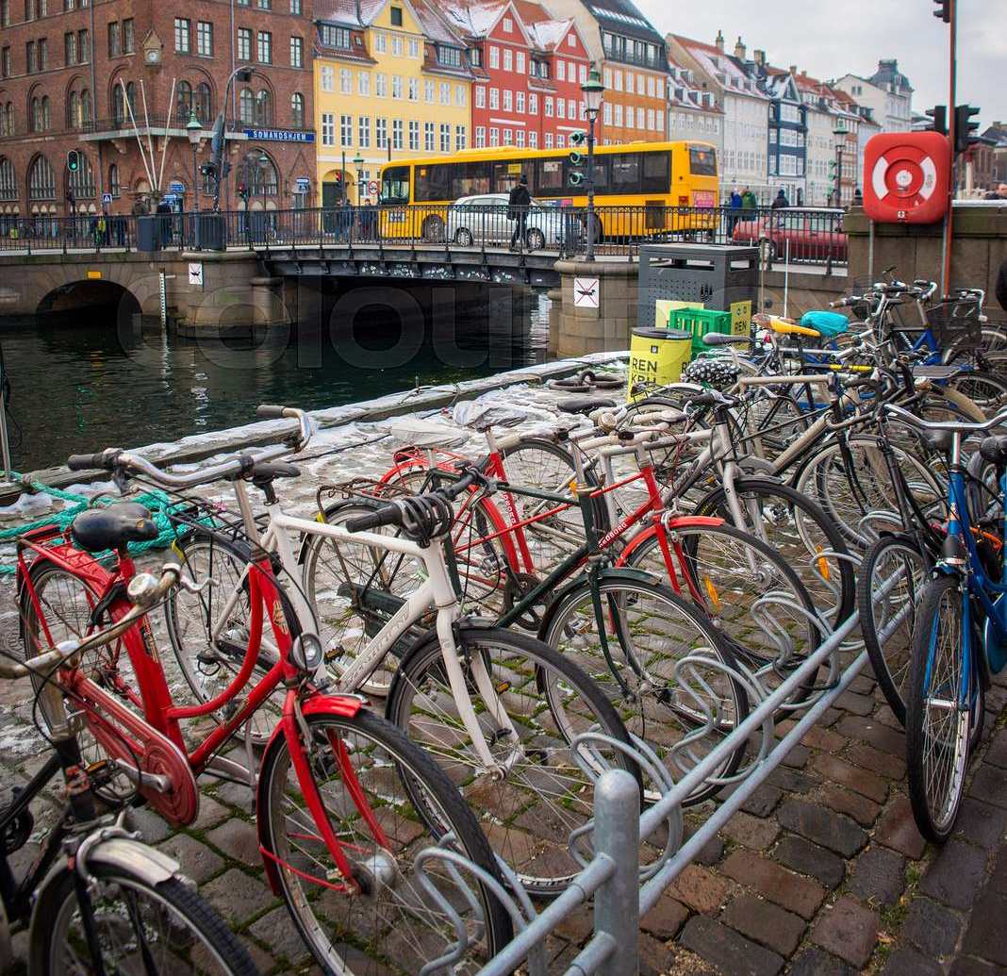
MOVE – FIMO – (Mobility Across)
Joint meeting 2021
Involvement of users and stakeholders in new solutions
Why and how to do it?
Learnings and effect on solutions.
What are the role for planners?
How is future models for transport – rural and urban connections?
New business models / finance models /business case

