Slide 1
Critical Theory
+
System Thinking
=
Critical System Thinking
Hans de Bruin (HZ University of Applied Sciences, Big Picture Lab)
March 2020

Slide 2

Transities:
Klimaatverandering
Digitalisering
Consumptie
Antwoorden:
Markt
Vesting
Wat is het perspectief?
Kunnen we veranderen?

Slide 3
Wicked problems
The problem involves many stakeholders with different values and priorities.
The issue’s roots are complex and tangled.
The problem is difficult to come to grips with and changes with every attempt to address it.
The challenge has no precedent.
There’s nothing to indicate the right answer to the problem.
Nevertheless, in our experiences, it is possible to make progress by using the right methods.

Slide 4
Contents
Critical theory
Systems thinking
Second order cybernetics: Laws of Form and observing
Critical Systems Heuristics (CSH) + exercise
Trends

Slide 5
Critical theory
A social theory oriented toward critiquing and changing society as a whole.
  In contrast to traditional theory oriented only to understanding or explaining it.
Critical theories aim to dig beneath the surface of social life and uncover the assumptions that keep us from a full and true understanding of how the world works.

Slide 6
Critical theory
Critical theory as it is known today can be traced to Marx's critique of economy.
  The relationship between economic base and ideological superstructure, and tends to focus on how power and domination operate, in particular, in the realm of the superstructure.
Frankfurt School
  Max Horkheimer asserted that a critical theory must do two important things: it must account for the whole of society within historical context, and it should seek to offer a robust and holistic critique by incorporating insights from all social sciences.
  Further, Horkheimer stated that a theory can only be considered a true critical theory if it is explanatory, practical, and normative, meaning that the theory must adequately explain the social problems that exist, it must offer practical solutions for how to respond to them and make change.

Slide 7
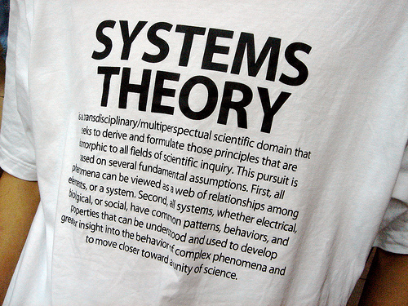

Slide 8
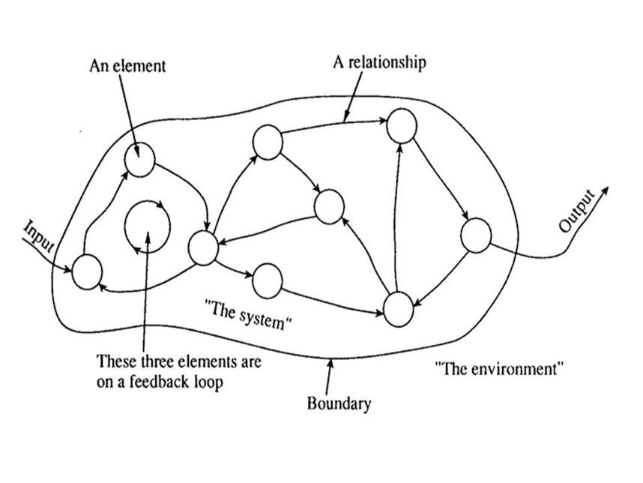
Systems theory
Elements can be anything, e.g., humans, organizations and machines.
New, emergent properties arise from the relations between elements, which cannot be explained by understanding the individual elements.
A systems approach begins when first you see the world through the eyes of another.
(C.W. Churchman, 1968)

Slide 9
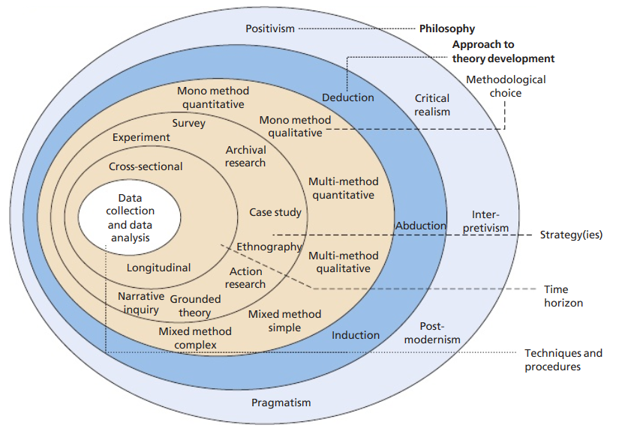
Research onion (Saunders et al., 2015)

Slide 10
Hard systems thinking
Research philosophy: positivism
Prediction and control
But inaccurate for human systems: conflict and discord
  Different worldviews, not a common goal
  Strive for an optimal solution regardless of different opinions or values
  Success depends on:
    Common goal (realistic?)
    Objectives determined by those in power

Slide 11
Soft systems thinking
Research philosophy: interpretivism
  Includes the cultural, psychological processes of human activity
Social system is constructed by individuals
  Interpret the viewpoints of individuals rather than taking an outsiders view
Not able to persuade with those in power to participate

Slide 12
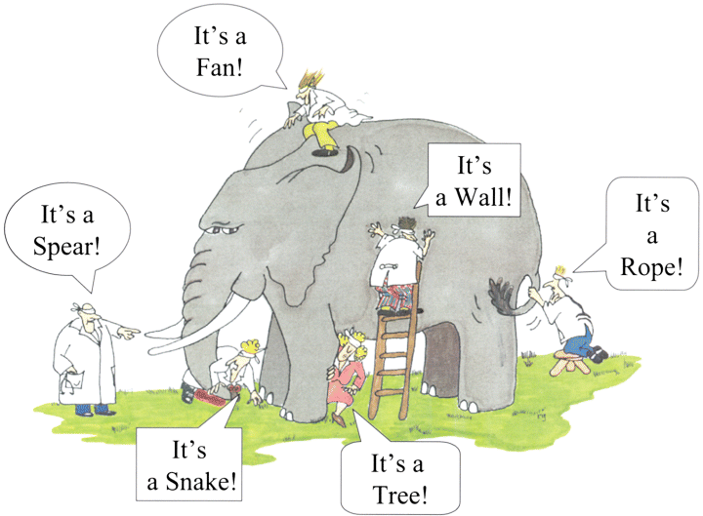

Slide 13
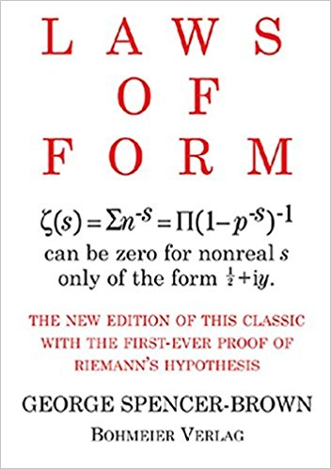
The very basics: Laws of Forms
George Spencer-Brown
We take as given the idea of distinction and the idea of indication, and that one cannot make an indication without drawing a distinction. We take, therefore, the form of distinction for the form.
Definition: distinction is perfect continence.
Foundational for:
Autopoeisis and the Biology of cognition (Maturana and Varela)
Neo-cybernetics and second-order observing (Heinz von Foerster)
Luhmann’s social theory: society as closed, autopoeitic, self-referential systems of communications.

Slide 14
Some-Thing
No-Thing

Slide 15
Laws of Forms
The theme of this book is that a universe comes into being when a space is severed or taken apart. The skin of a living organism cuts off an inside from an outside. So does the circumference of a circle in a plane. By tracing the way we represent such a severance, we can begin to reconstruct, with an accuracy and coverage that appear almost uncanny, the basic forms underlying linguistic, mathematical, physical, and biological science, and can begin to see how the familiar laws of our own experience follow inexorably from the original act of severance. The act is itself already remembered, even if unconsciously, as our first attempt to distinguish different things in a world where, in the first place, the boundaries can be drawn anywhere we please.

Slide 16
Book of Genesis
In the beginning God created the heavens and the earth. Now the earth was formless and empty, darkness was over the surface of the deep, and the Spirit of God was hovering over the waters.
And God said, “Let there be light,” and there was light. God saw that the light was good, and he separated the light from the darkness. God called the light “day,” and the darkness he called “night.” And there was evening, and there was morning—the first day.
God has made his first distinction after the first day: the distinction between light and darkness. And this was the starting point of many more distinctions eventually resulting in God’s creation of mankind as an image of his own.

Slide 17
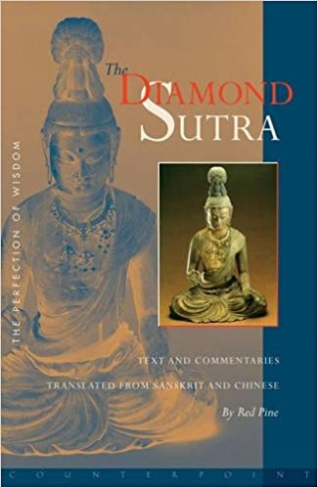
The logic of not
The Diamond Sutra – The perfection of wisdom
When we perceive things, we generally use the sword of conceptualization to cut reality into pieces, saying, 'This piece is A, and A cannot be B, C, or D.'
But when A is looked at in light of dependent co-arising, we see that A is comprised of B, C, D, and everything else in the universe. 'A' can never exist by itself alone.
When we look deeply into A, we see B, C, D, and so on. Once we understand that A is not just A, we understand the true nature of A and are qualified to say "A is A," or "A is not A." But until then, the A we see is just an illusion of the true A.
A is not A, therefore it is A
The diamond that cuts through afflictions, ignorance, illusion, or delusion.
Central theme: emptiness

Slide 18
Distinction is perfect continence
The circle “makes” a distinction in the plane.
We make a distinction in the plane by drawing a circle.
Circle and observer arise together in the act of perceiving.
That circle, this observer, and the distinction that arises are one.
The Form we take to exist arises from framing nothing.
By starting in unity we make imaginary complexity, related to the original unity.
Every distinction is inherently a process, and the structure of our world as a whole comes from the relationships whose exploration constitutes that world. It is a reflexive domain there is no place to hide, no irreducible object. Any given entity acquires its properties through its relationships with everything else.

Slide 19
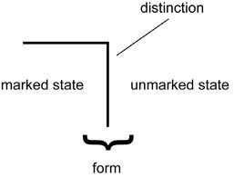
Mark of Distinction some-thing from no-thing
We cannot make an indication without drawing a distinction.
This tiny symbol has the power to indicate several things at once:
  The outside/inside (emptiness, void, nothing, the unmarked state)
  The inside/outside (something, the marked state)
  The distinction as a sign (indication)
  The distinction as an operation of making a distinction
  The observer, the one that makes the distinction

Slide 20
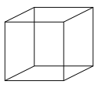
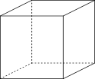
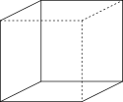

Blind spot
Necker cube
Rubin vase

Slide 21
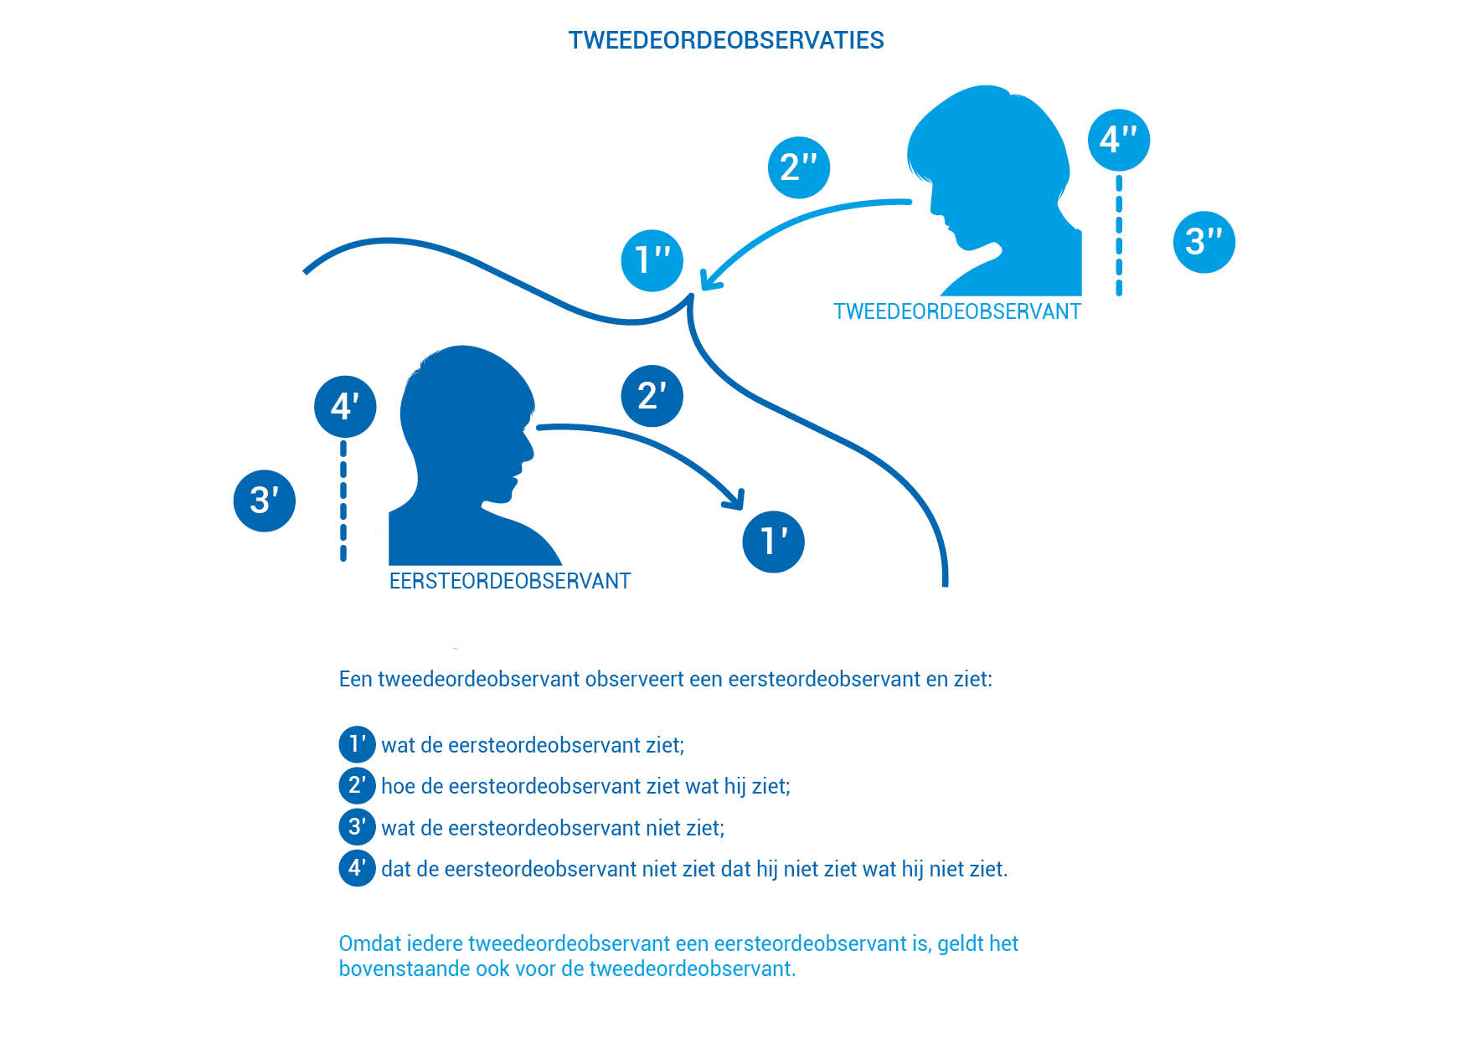

Slide 22
Self-reference - Re-entry in the Form
(according to Fransisco Varela)
The emergence of the mark itself requires self-reference, for there can be no mark without a distinction and there can be no distinction without indication (Spencer-Brown says there can be no indication without a distinction. This argument says it the other way around.). Indication is itself a distinction, and one sees that the act of distinction is necessarily circular.

Slide 23

Self-reference
An unconscious reference to one’s own cultural values, experiences and knowledge as a basis for decisions.

Slide 24
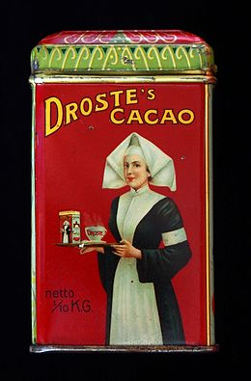
Self-reference

Slide 25
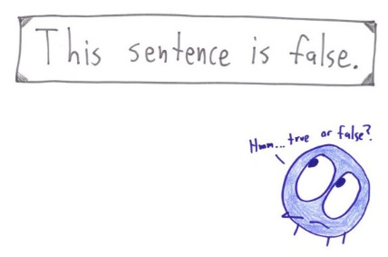
Self-reference

Slide 26
Laws
Law of condensation
Law of cancellation
Corresponds with

Slide 27



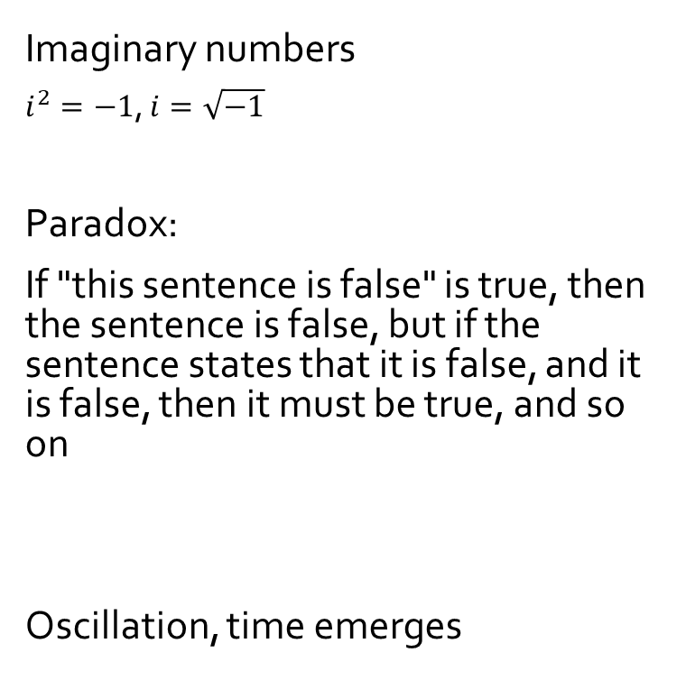



Self-reference
Imaginary numbers
$i^{2}=−1$, $i=\sqrt{−1}$
Paradox:
If "this sentence is false" is true, then the sentence is false, but if the sentence states that it is false, and it is false, then it must be true, and so on
Oscillation, time emerges
Factorial
$x^{2}+1=$ 0
$x$ $=+1 → x=−1$
n!$=n ∗\left(n−1\right)!$
$x$ $=\frac{−1}{x}$
$x$ $=−1 → x=+1$
$$0!=1$$
f
f
f
f
f
f
f
f

Slide 28
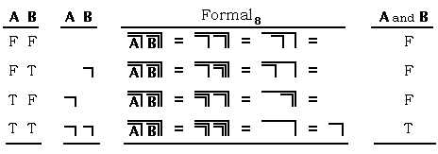
Boolean algebra
False
True
~a
a
a and b
a
b
a or b
ab

Slide 29
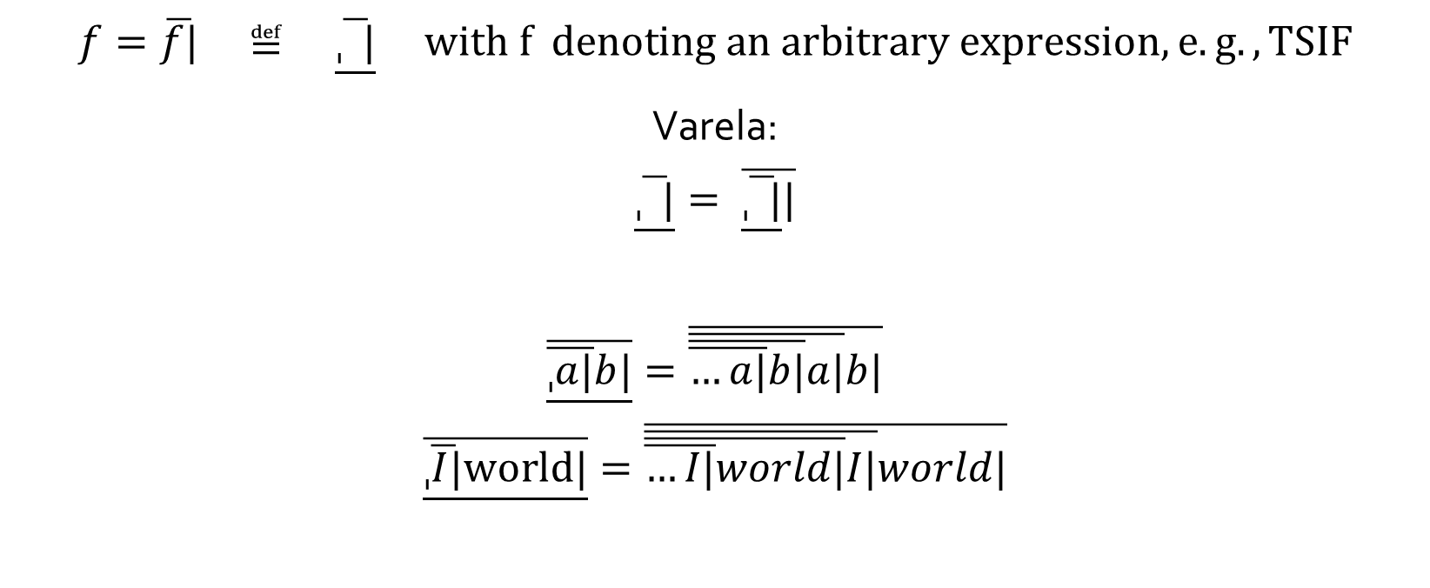
Imaginary, boundary state
$$f=\overline{f|} ≝ \underline{\overline{ˌ |}} with f denoting an arbitrary expression, e.g., TSIF$$
Varela:
$$\underline{\overline{ˌ |}}= \overline{\underline{\overline{ˌ |}}|}$$
$$\underline{\overline{\overline{ˌa|}b|}}=\overline{\overline{\overline{\overline{…a|}b|}a|}b|}$$
$$\underline{\overline{\overline{ˌI|}world|}}=\overline{\overline{\overline{\overline{…I|}world|}I|}world|}$$

Slide 30
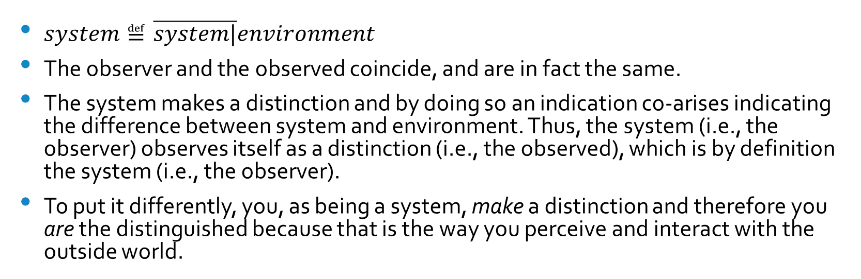
Self-production (autopoiesis)
$system≝\overline{system|}environment$
The observer and the observed coincide, and are in fact the same.
The system makes a distinction and by doing so an indication co-arises indicating the difference between system and environment. Thus, the system (i.e., the observer) observes itself as a distinction (i.e., the observed), which is by definition the system (i.e., the observer).
To put it differently, you, as being a system, make a distinction and therefore you are the distinguished because that is the way you perceive and interact with the outside world.

Slide 31
System characteristics
Self-referential, self-producing, and autonomous
Organizationally closed, structurally open
We have to become what we are not,
and yet remain the same.

Slide 32
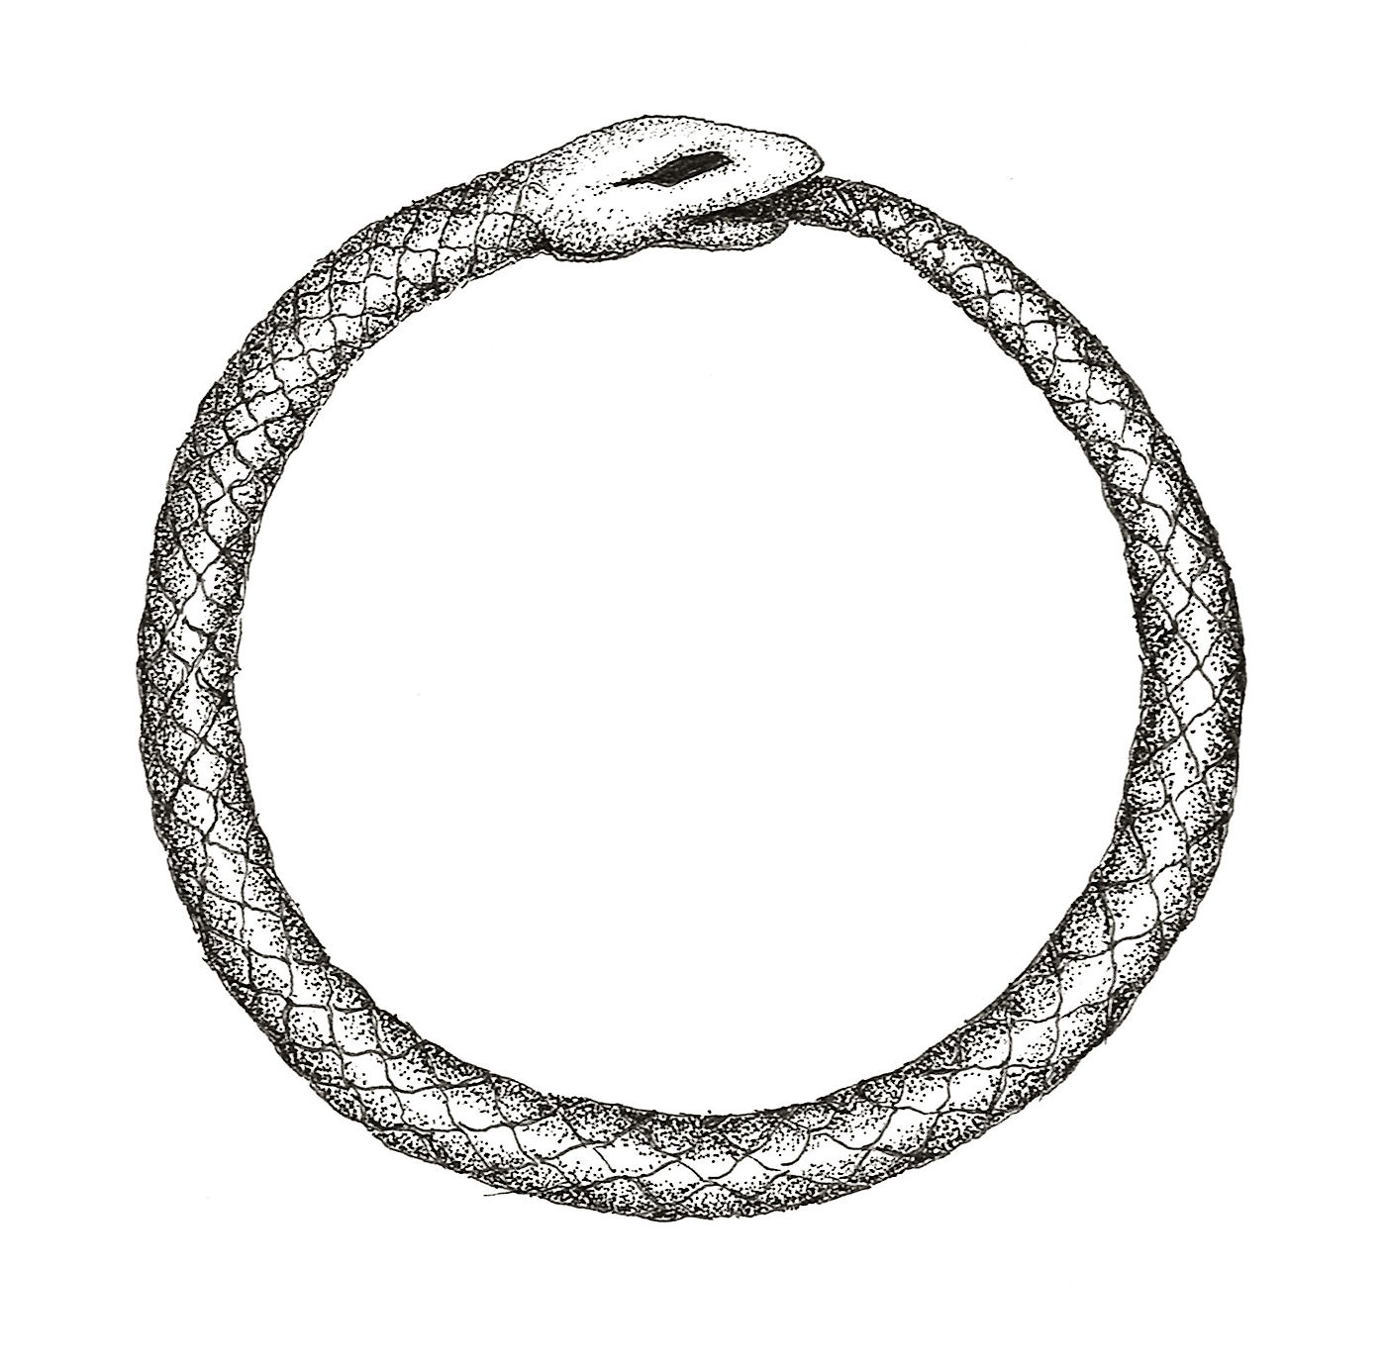
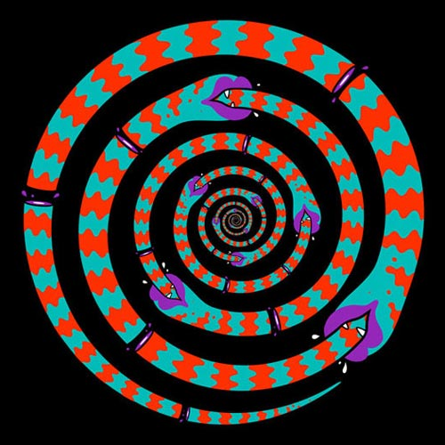
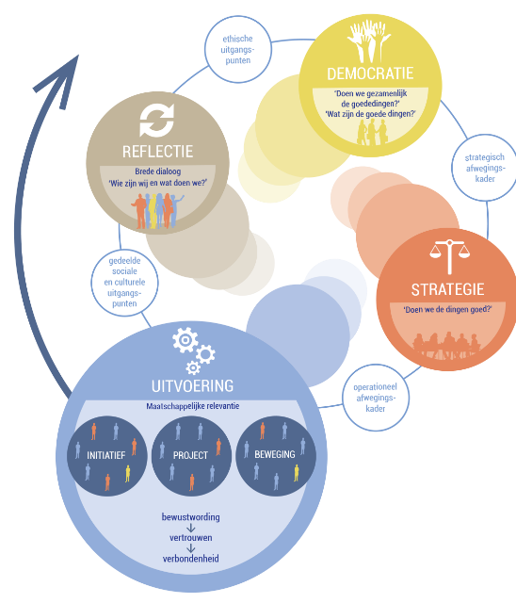
Ouroboros
Ouroboros betekent staart-eter, een slang die zich zelf opeet en op die manier een eeuwige cirkel vormt.
Het symboliseert de cyclische aard van de natuur, het eeuwige terugkeren en de eenheid van alles.

Slide 33
Frankfurt school: Jürgen Habermas
Habermas' Three Generic Domains of Human Interest
Habermas differentiates three primary generic cognitive areas in which human interest generates knowledge. These areas define cognitive interests or learning domains, and are grounded in different aspects of social existence -- work, interaction and power.
Cognitive areas:
  Work Knowledge
  Practical Knowledge
  Emancipatory Knowledge

Slide 34
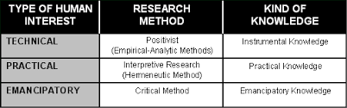
Frankfurt school: Jürgen Habermas

Slide 35
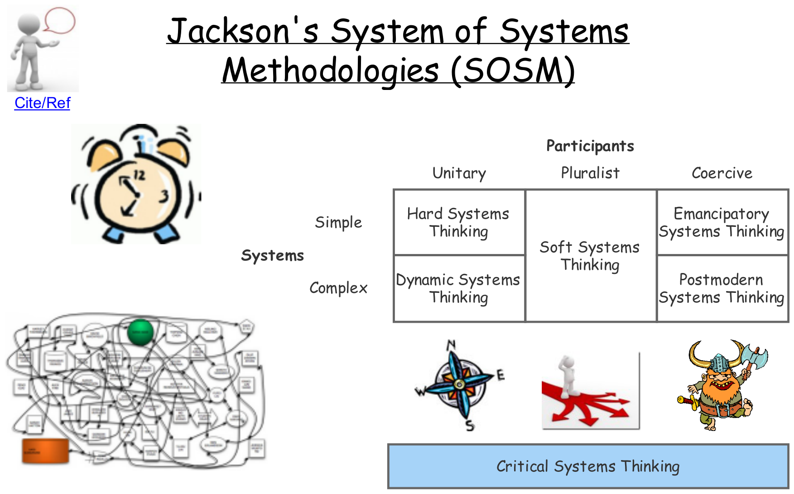

Slide 36
Critical Systems Thinking (CST)
Research philosophy: critical realism
Premise: shared culture
  Reconstruct meaning that is shared, not just opinions (soft systems approaches)
Incorporating critical theory: seeks to create change, to the benefit of those oppressed
  Issues of power
  Oppression
  Emancipation

Slide 37
Critical Systems Thinking (CST)
Commitments:
Critical awareness
Improvement (not just emancipation)
Pluralism (theoretical and methodological)

Slide 38
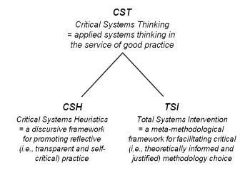
Critical systems thinking

Slide 39
Critical Systems Heuristics (CSH)
Developed by Werner Ulrich
Concerned with purposive (with a predefined goal) and purposeful (means and ends are subject of inquiry) evaluation
Starting points:
  Infinite richness of the real world
  Our understandings are therefore inherently incomplete
  Selective application of knowledge
Instead of focusing on stances and actions themselves (worldviews of the situation), asking, what are the underlying assumptions: values, power structures, knowledge bases and moral stances.
Researcher is agent of change, CSH intends to generate discussion, reflection and critique.

Slide 41
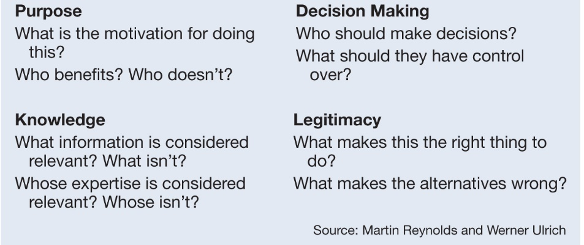
Boundary judgements

Slide 42
Aan de slag
Analyseer een case
Case op zich is niet belangrijk, kan zijn energietransitie, omgevingsvisie, dementie, eenzaamheid, etc. (aannames maken mag in deze setting ;-))
Wie zijn de belanghebbenden, wat zijn hun belangen (waar maken ze zich druk om, en waar komt dat vandaan), wat is de stip op de horizon, is die gedeeld, hoe past die stip in een groter geheel, zijn er barrières, en zo ja, hoe kunnen die worden geslecht?
Maak de case inzichtelijk, bijvoorbeeld met een rijk plaatje.

Slide 43
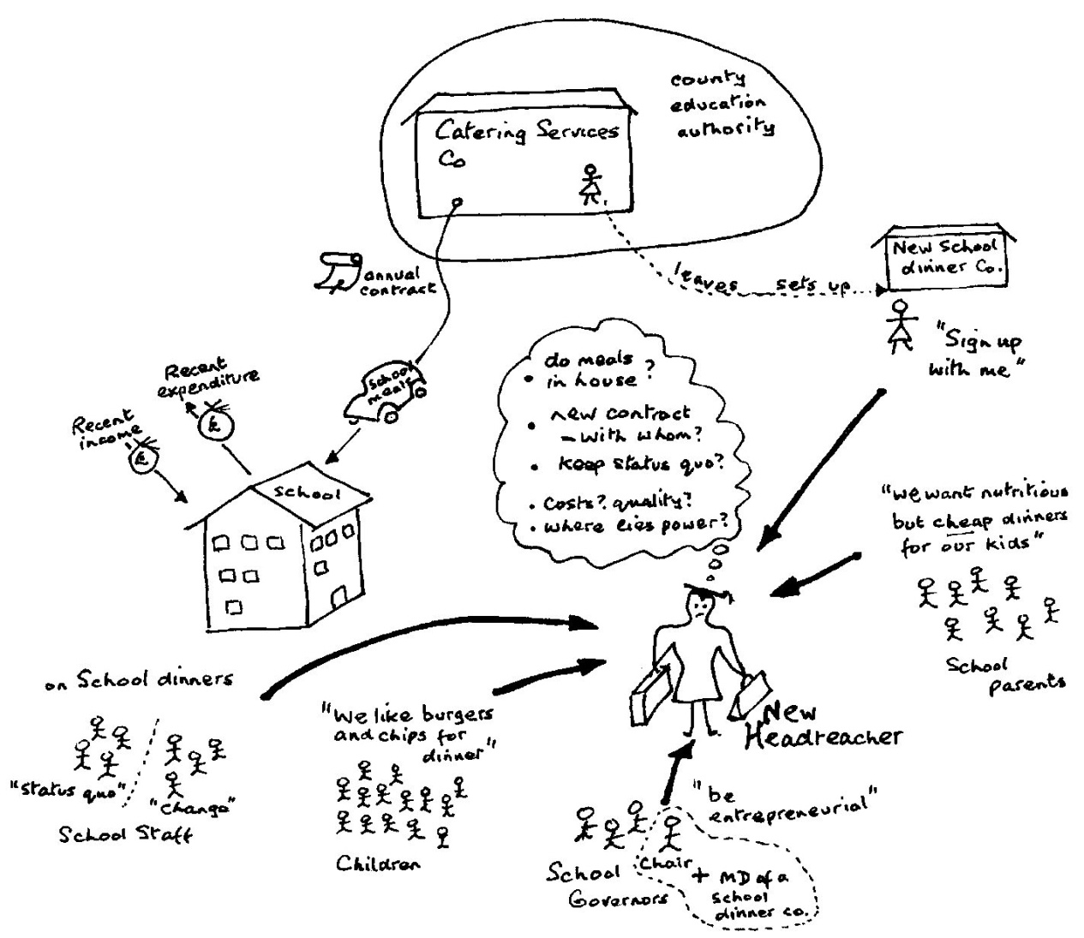
Finding out - making rich pictures
No rules!
Aspects:
  Stakeholders
  Concerns/issues
  Structure
  Process

Slide 44
Sources of Motivation
  Who is (ought to be) the client? That is, whose interests are (should be) served?
  What is (ought to be) the purpose? That is, what are (should be) the consequences?
  What is (ought to be) the measure of improvement? That is, how can (should) we determine that the consequences, taken together, constitute an improvement?
Sources of Power
  Who is (ought to be) the decision-maker? That is, who is (should be) in a position to change the measure of improvement?
  What resources are (ought to be) controlled by the decision-maker? That is, what conditions of success can (should) those involved control?
  What conditions are (ought to be) part of the decision environment? That is, what conditions can (should) the decision-maker not control (e.g. from the viewpoint of those not involved)?
Sources of Knowledge
  Who is (ought to be) considered a professional? That is, who is (should be) involved as an expert, e.g. as a researcher, planner or consultant?
  What expertise is (ought to be) consulted? That is, what counts (should count) as relevant knowledge?
  What or who is (ought to be) assumed to be the guarantor of success? That is, where do (should) those involved seek some guarantee that improvement will be achieved - for example, consensus among experts, the involvement of stakeholders, the experience and intuition of those involved, political support?
Sources of Legitimation
  Who is (ought to be) witness to the interests of those affected but not involved? That is, who is (should be) treated as a legitimate stakeholder, and who argues (should argue) the case of those stakeholders who cannot speak for themselves, including future generations and non-human nature?
  What secures (ought to secure) the emancipation of those affected from the premises and promises of those involved? That is, where does (should) legitimacy lie?
  What worldview is (ought to be) determining? That is, what different visions of `improvement’ are (ought to be) considered, and how are they (should they be) reconciled?

Slide 45
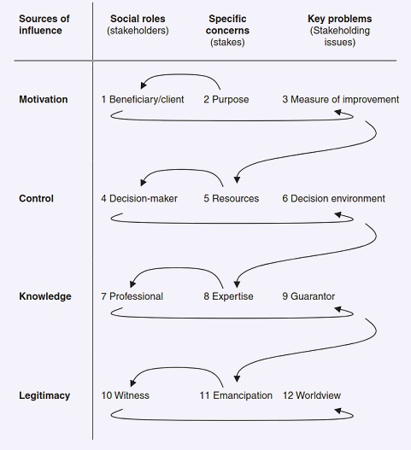

Slide 46
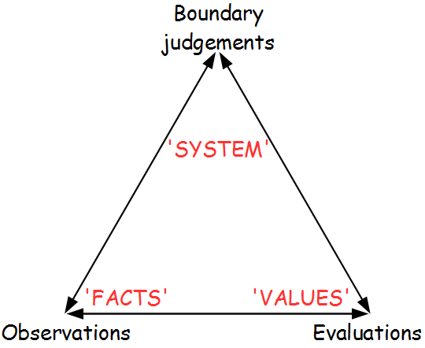
Boundary judgements
System as a difference: the difference between system and environment (Luhmann)

Slide 47
Aan de slag
Vervolg
Wat zijn de boundary judgements die door de diverse belanghebbenden worden gemaakt? (Aannames maken mag in deze setting ;-))

Slide 48
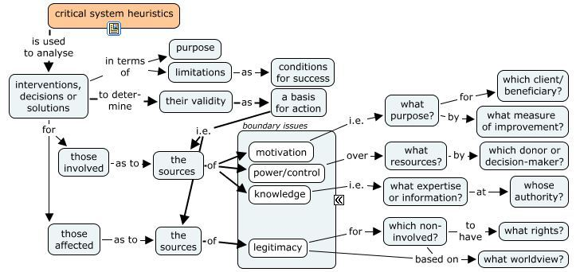
Source: CSL4D

Slide 49
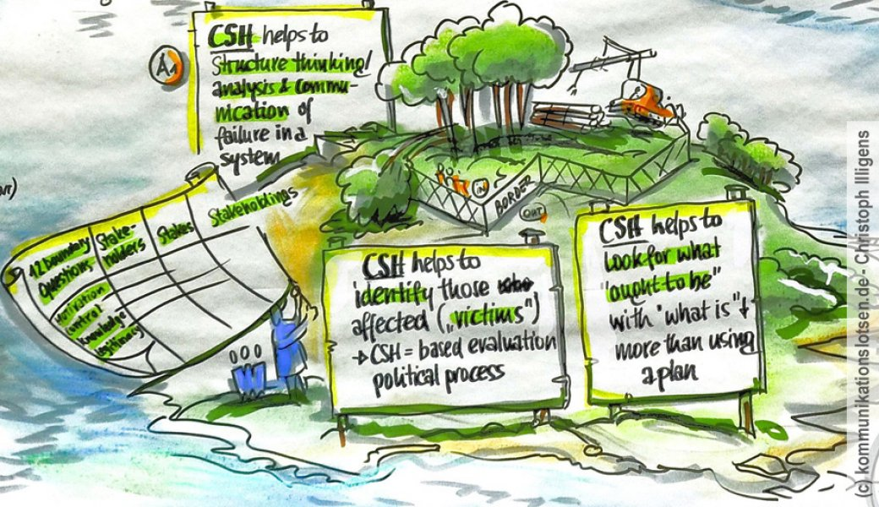

Slide 50

Embedding CSH in a system approach
SSM process
Four steps to address a problematic situation:
  Finding out (the stakeholders and their concerns)
  Model building (explicating worldviews)
  Discussing and debating (accommadating worldviews)
  Taking action (improving the problematic situation)
In essence, this is a group learning process

Slide 51
CSH critique
CSH does not explain how ideas have risen, i.e., how values and beliefs arise and how power is shaped and maintained by structures of society.
Why bother to engage in dialog by those in power?
  What if the should be embarrassed does not feel embarrassed?
CSH can not deal with coercive situations:
  Closure of debate
  CSH might be difficult to use by some
    It might create an oppressive relation
  Higher power is needed: political action and campaigning
On what basis is someone identified as oppressed?
  Who or what gives the right to speak for the oppressed?
Cooperative model, whereas humans are inclined to competition
  CSH does not educate
CSH is not a methodological pluralistic model
  It must be embedded in other methods

Slide 52
Research onion (Saunders et al., 2015)

Slide 53
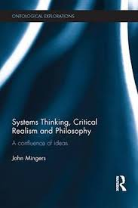

Slide 54
Critical realism
Focuses on explaining what we see and experience in terms of underlying structures of reality that shape the observable events
Reality: external and independent, not directly accessible through observation and knowledge of it
Epistemological relativism
  Knowledge is historically situated
  Social facts are social constructs agreed on by people rather than existing independently
Causality cannot be reduced to statistical correlations

Slide 55
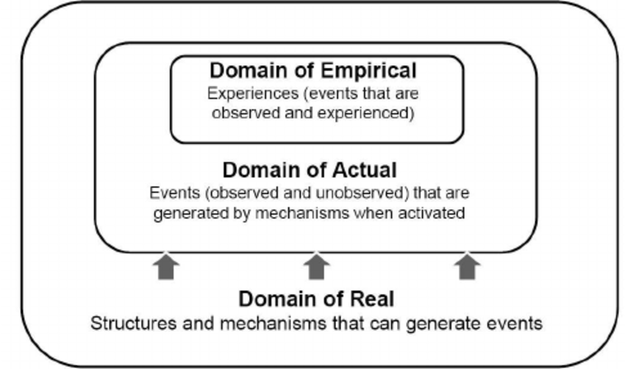
Critical realism

Slide 56
Critical realism
No social theory can be purely descriptive: it must be evaluative, and thus there can be no split between facts and values. Following from this is the view that social theory is inevitably transformative, providing an explanatory critique that logically entails action.

Slide 57
Can critical system thinking bring about change?

Slide 58
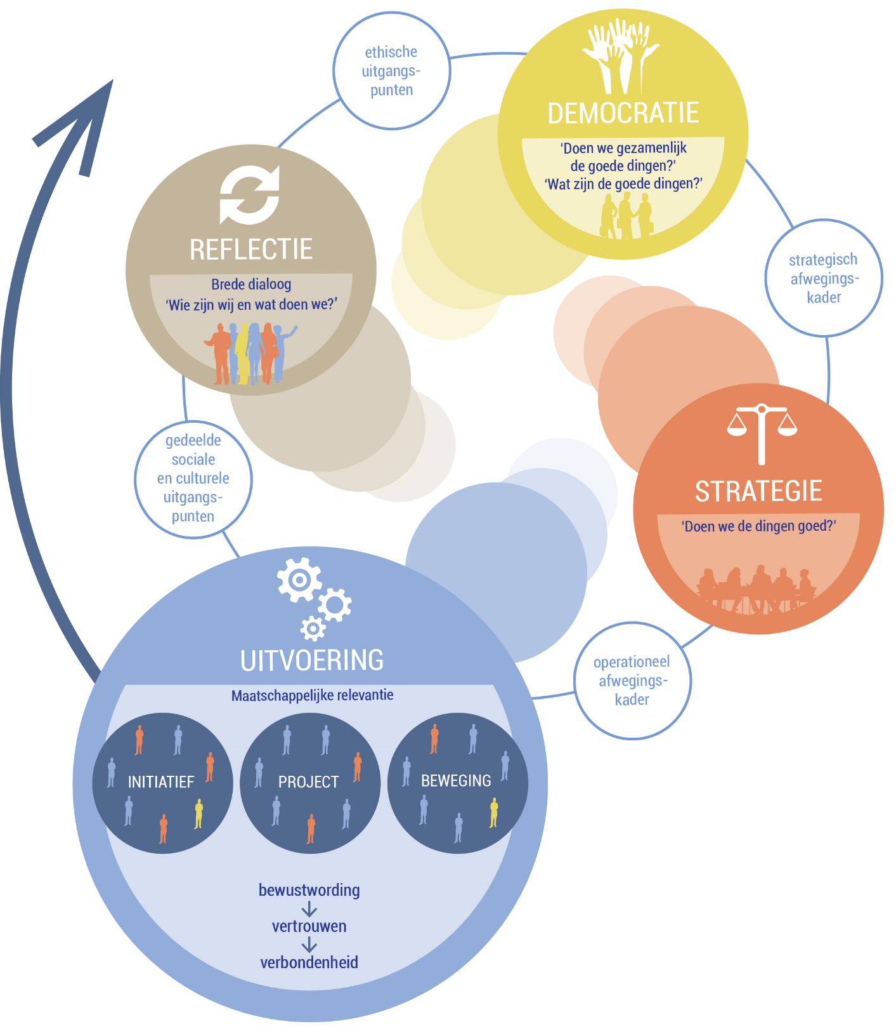
Duurzame,
samen lerende
maatschappij

Slide 59
Kernideeën
Verificatie en Validatie
  Verificatie: doen we de dingen goed?
  Validatie 1: doen we de goede dingen?
  Validatie 2: doen we gezamenlijk de goede dingen?
Verbondenheid en beweging
Proces, niet de uitkomst
  Aanhaken op bestaande ontwikkelingen
  In gezamenlijkheid, geen wij-zij, maar ons door dialoog
  Sturen op wat ons bindt, met respect voor diversiteit
  Continue herijking, doorlopend proces
Maak lokaal het verschil
Speelveld verbreden
  Kritische reflectie
  Houding en vaardigheden

Slide 60
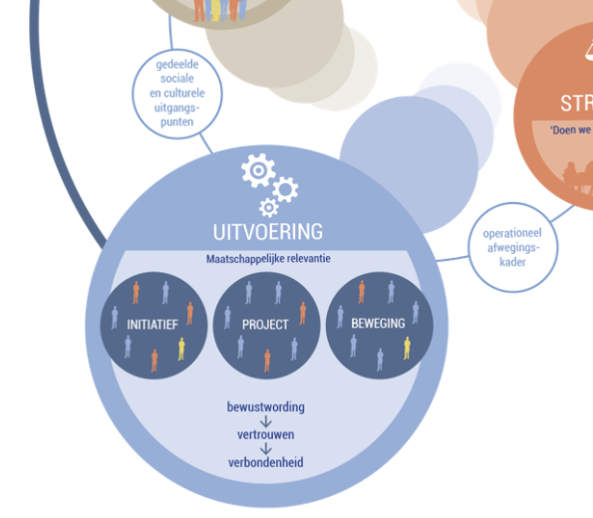
Uitvoering
Maatschappelijke relevantie
Mens en (sociale en fysieke) omgeving staan centraal
  Acceptabel niveau van leven
  Welvarende samenleving
Bewustwording → Vertrouwen→ Verbondenheid
  In gezamenlijkheid, geen wij-zij
Driedubbelslag
  Vooruitgang brengen in problematische situatie
  Kritische reflectie, een vaardigheid en een houding
  Geleerde lessen destilleren

Slide 61
Final remarks
CT and ST is a happy marriage. CST, by incorporating critical and systems theory, ensures an emancipatory and critical approach by the researcher to the system being examined.
Systems thinking without critique is blind with respect to its underpinning [system] boundary judgements and their normative implications. Ulrich, 2003.
When researching a complex system, critical theory without system thinking is likewise limited with respect to understanding the system, its components, boundaries and relations to one another. Watson and Watson, 2011.

